Slide 1



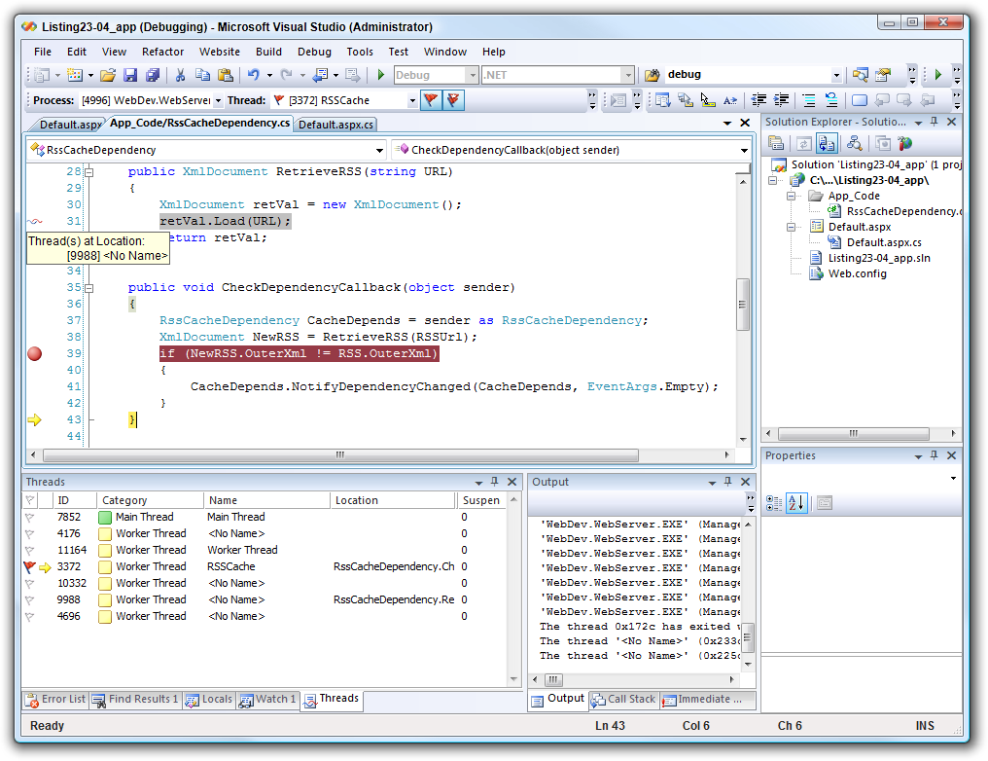

Debugging
Building Rock-Solid Software
High-Quality Code
SoftUni Team
Technical Trainers
http://softuni.bg
Software University

Slide 2

Table of Contents
Introduction to Debugging
Visual Studio Debugger
Breakpoints
Data Inspection
Finding a Defect

Slide 3
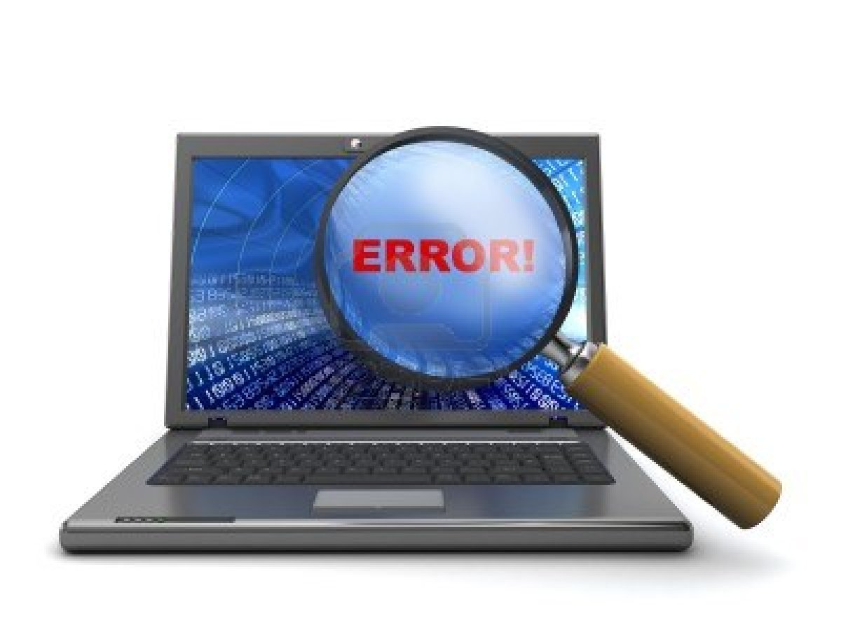
Introduction to Debugging

Slide 4
What is Debugging?
The process of locating and fixing or bypassing bugs (errors) in computer program code
To debug a program:
Start with a problem
Isolate the source of the problem
Fix it
Debugging tools (called debuggers) help identify coding errors at various development stages

Slide 5
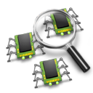

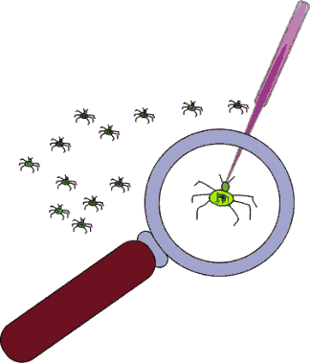
Debugging vs. Testing
Testing
A means of initial detection of errors
Debugging
A means of diagnosing and correcting the root causes of errors that have already been detected
Notes:
Some programmers use the terms "testing" and "debugging" interchangeably, but careful programmers distinguish between the two activities.
Testing is a means of detecting errors. Debugging is a means of diagnosing and correcting the root causes of errors that have already been detected.

Slide 6
Importance of Debugging
$60 Billion per year in economic losses due to software defects
Perfect code is an illusion
There are factors that are out of our control
Legacy code
You should be able to debug code that is written years ago
Deeper understanding of system as a whole

Slide 7
Debugging Philosophy
Debugging can viewed as one big decision tree
Individual nodes represent theories
Leaf nodes represent possible root causes
Traversal of tree boils down to process state inspection
Minimizing time to resolution is key
Careful traversal of the decision tree
Pattern recognition
Visualization and ease of use helps minimize time to resolution

Slide 8
Example Debugging - Decision Tree
OutOfMemoryException
.NET Heaps?
Virtual?
Native Heaps?
Native?
.NET Types?
Long references?
Native Heaps?

Slide 9
Visual Studio Debugger

Slide 10
Visual Studio Debugger
Visual Studio IDE gives us a lot of tools to debug your application
Adding breakpoints
Visualize the program flow
Control the flow of execution
Data tips
Watch variables
Debugging multithreaded programs
and many more…

Slide 11
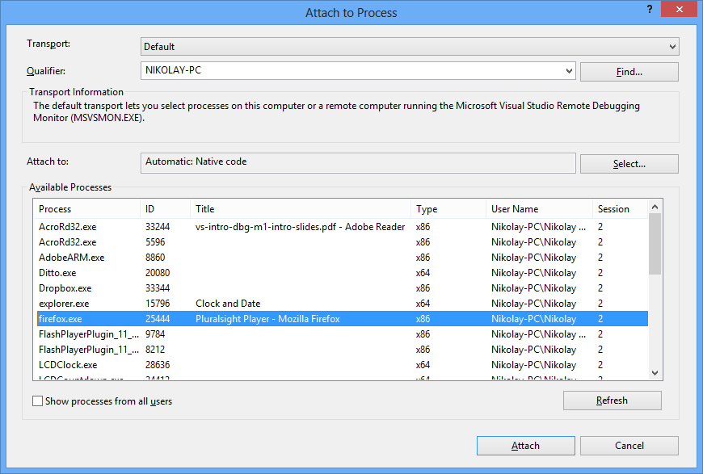
How To Debug a Process
Starting a process under the Visual Studio debugger
Attaching to an already running process
Without a solution loaded you can still debug
Useful when solution isn't readily available
Debug menu -> Attach to Process

Slide 12
Debugging a Solution
Debug menu, Start Debugging item
F5 is a shortcut
Easier access to the source code and symbols since its loaded in the solution
Certain differences exist in comparison to debugging an already running process
Hosting for an ASP.NET application
Visual Studio uses a replacement of the real IIS

Slide 13
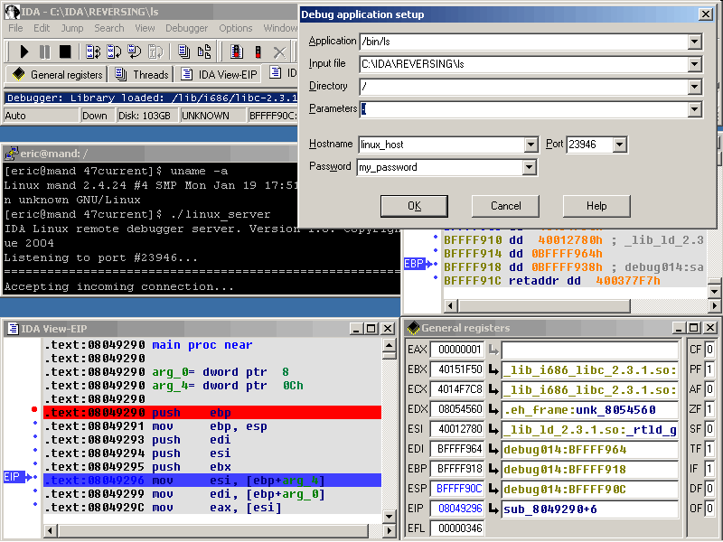
Debug Windows
Debug Windows are the means to introspect on the state of a process
Opens a new window with the selected information in it
Window categories
Data inspection
Threading
Accessible from menu
Debug -> Windows

Slide 14
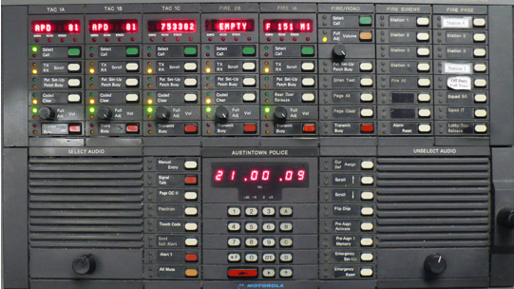
Debugging Toolbar
Convenient shortcut to common debugging tasks
Step into
Step over
Continue
Break
Breakpoints
Customizable to fit your needs
Add / Remove buttons

Slide 15
Controlling Execution
By default, an app will run uninterrupted (and stop on exception or breakpoint)
Debugging is all about looking at the state of the process
Controlling execution allows:
Pausing execution
Resuming execution
Stepping through the application in smaller chunks
In the case of IntelliTrace (recording steps), allows backward and forward stepping

Slide 16
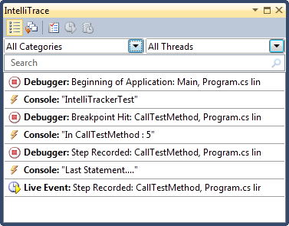
IntelliTrace
IntelliTrace operates in the background, records what you are doing during debugging
You can easily get a past state of your application from IntelliTrace
You can navigate through your code
and see what's happened
To navigate, just click any of the events
that you want to explore

Slide 17
Options and Settings
Visual Studio offers quite a few knobs and tweaks in the debugging experience
Options and settings is available via Debug -> Options and Settings
Examples of Options and Settings
Enable just my code (ignore other code)
Enable .NET framework source stepping
Source server support
Symbols (line numbers, variable names)
Much more…

Slide 18

Breakpoints

Slide 19
Breakpoints
Ability to stop execution based on certain criteria is key when debugging
When a function is hit
When data changes
When a specific thread hits a function
Much more…
Visual Studio's debugger has a huge feature set when it comes to breakpoints

Slide 20
Visual Studio Breakpoints
Stops execution at a specific instruction (line of code)
Can be set using Debug->Toggle breakpoint
F9 shortcut
Clicking on the left most side of the source code window
By default, the breakpoint will hit every time execution reaches the line of the code
Additional capabilities: condition, hit count, value changed, when hit, filters

Slide 21
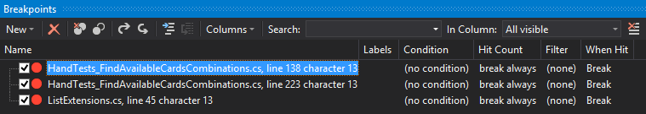
Managing Breakpoints
Managed in the breakpoint window
Adding breakpoints
Removing or disabling breakpoints
Labeling or grouping breakpoints
Export/import breakpoints

Slide 22
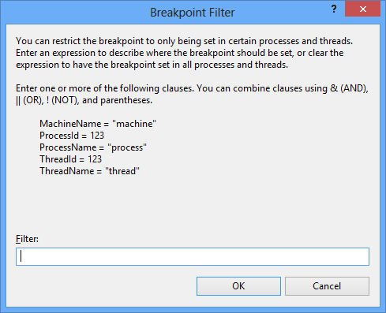
Breakpoint Filters
Allows you to excerpt even more control of when a breakpoint hits
Examples of customization
Machine name
Process ID
Process name
Thread ID
Thread name
Multiple can be combined using &, ||, !

Slide 23
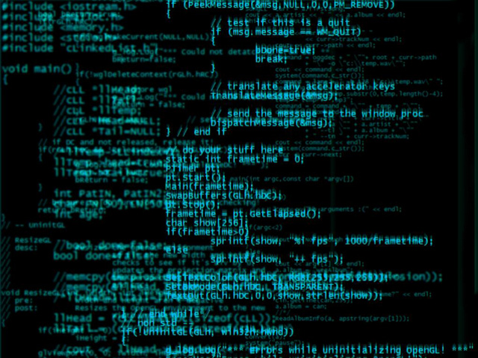

Data Inspection

Slide 24
Data Inspection
Debugging is all about data inspection
What are the local variables?
What is in memory?
What is the code flow?
In general - What is the state of the process right now and how did it get there?
As such, the ease of data inspection is key to quick resolution of problems

Slide 25
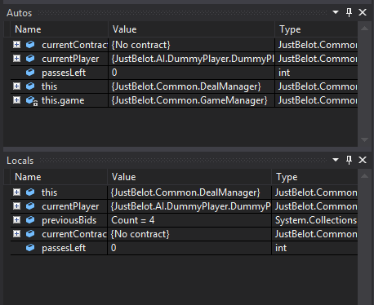
Visual Studio Data Inspection
Visual Studio offers great data inspection features
Watch windows
Autos and Locals
Memory and Registers
Data Tips
Immediate window

Slide 26
Watch Window
Allows you to inspect various states of your application
Several different kinds of "predefined" watch windows
Autos
Locals
"Custom" watch windows also possible
Contains only variables that you choose to add
Right click on the variable and select "Add to Watch"

Slide 27
Autos and Locals
Locals watch window contains the local variables for the specific stack frame
Debug -> Windows -> Locals
Displays: name of the variable, value and type
Allows drill down into objects by clicking on the + sign in the tree control
Autos lets the debugger decide which variables to show in the window
Loosely based on the current and previous statement

Slide 28
Memory and Registers
Memory window can be used to inspect process wide memory
Address field can be a raw pointer or an expression
Drag and drop a variable from the source window
Number of columns displayed can be configured
Data format can be configured
Registers window can be used to inspect processor registers

Slide 29
Data Tips
Provides information about variables
Variables must be within scope of current execution
Place mouse pointer over any variable
Variables can be expanded by using the + sign
Pinning the data tip causes it to always stay open
Comments can be added to data tips
Data tips support drag and drop
Importing and exporting data tips

Slide 30
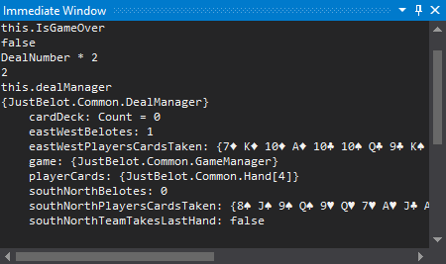
Immediate Window
Useful when debugging due to the expansive expressions that can be executed
To output the value of a variable <name of variable>
To set values, use <name of variable>=<value>
To call a method, use <name of variable>. <method>(arguments)
Similar to regular code
Supports IntelliSense

Slide 31

Threads and Stacks

Slide 32
Threads
Fundamental units of code execution
Commonly, programs use more than one thread
In .NET, there is always more than one thread
Each thread has a memory area associated with it known as a stack
Stores local variables
Stores frame specific information
Memory area employs last in first out semantics

Slide 33
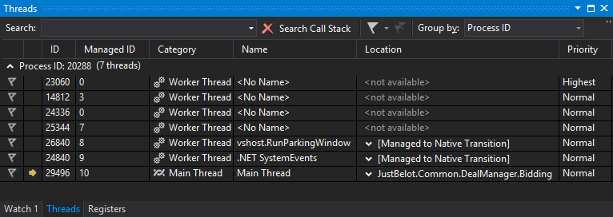
Threads Window
Contains an overview of thread activity in the process
Includes basic information in a per thread basis
Thread ID's
Category
Name
Location
Priority

Slide 34
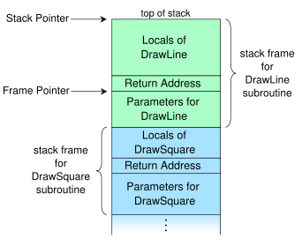
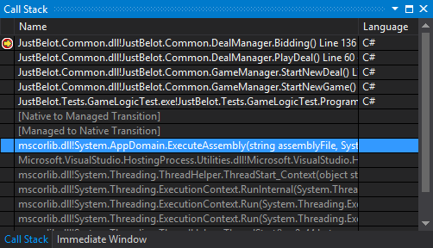
Call Stacks
A threads stack is commonly referred to as a call stack
Visual Studio shows the elements of a call stack
Local variables
Method frames

Slide 35

Finding a Defect

Slide 36

Finding a Defect
Stabilize the error
Locate the source of the error
Gather the data
Analyze the data and form hypothesis
Determine how to prove or disprove the hypothesis
Prove or disprove the hypothesis by 2c)
Fix the defect
Test the fix
Look for similar errors

Slide 37

Tips for Finding Defects
Use all available data
Refine the test cases
Check unit tests
Use available tools
Reproduce the error in several different ways
Generate more data to generate more hypotheses
Use the results of negative tests
Brainstorm for possible hypotheses

Slide 38

Tips for Finding Defects (2)
Narrow the suspicious region of the code
Be suspicious of classes and routines that have had defects before
Check code that's changed recently
Expand the suspicious region of the code
Integrate incrementally
Check for common defects
Talk to someone else about the problem
Take a break from the problem

Slide 39

Fixing a Defect
Understand the problem before you fix it
Understand the program, not just the problem
Confirm the defect diagnosis
Relax
Save the original source code
Fix the problem, not the symptom
Make one change at a time
Add a unit test that expose the defect
Look for similar defects
Source: http://www.movingseniorsbc.com

Slide 40

Psychological Considerations
Your ego tells you that your code is good and doesn't have a defect even when you've seen that it has.
How "Psychological Set" Contributes to Debugging Blindness

Slide 41

Debugging Techniques
Exercises in Class

Slide 42

Summary
Introduction to Debugging
Visual Studio Debugger
Breakpoints
Data Inspection
Locals, Autos, Watch
Finding a Defect

Slide 43
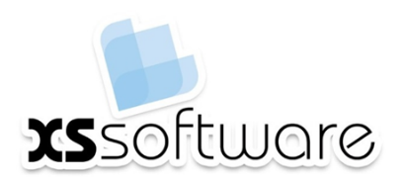








Debugging
http://softuni.org/courses/high-quality-code

Slide 44

License
This course (slides, examples, demos, videos, homework, etc.) is licensed under the "Creative Commons Attribution-NonCommercial-ShareAlike 4.0 International" license
Attribution: this work may contain portions from
"Fundamentals of Computer Programming with C#" book by Svetlin Nakov & Co. under CC-BY-SA license
"C# Part I" course by Telerik Academy under CC-BY-NC-SA license

Slide 45






Free Trainings @ Software University
Software University Foundation – softuni.org
Software University – High-Quality Education, Profession and Job for Software Developers
softuni.bg
Software University @ Facebook
facebook.com/SoftwareUniversity
Software University @ YouTube
youtube.com/SoftwareUniversity
Software University Forums – forum.softuni.bg

